Slide 1
Nutrients
October 15, 2019

Slide 2
Biologically essential nutrients

Slide 3
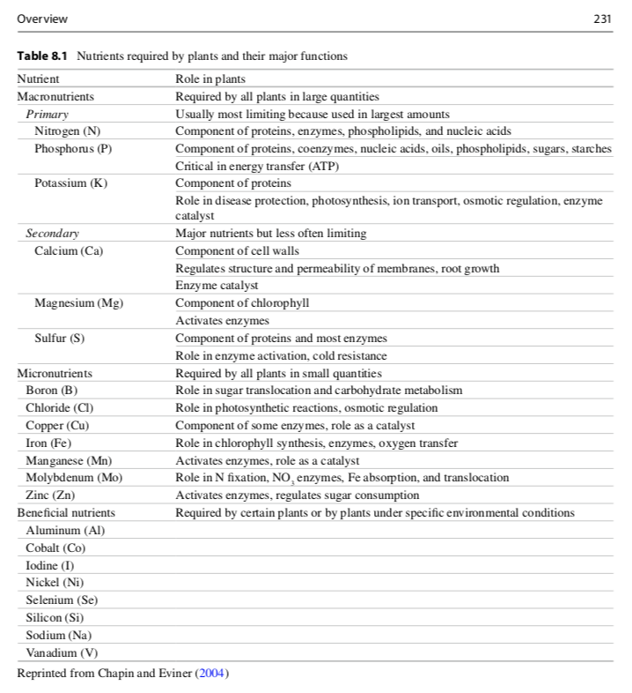

Slide 4
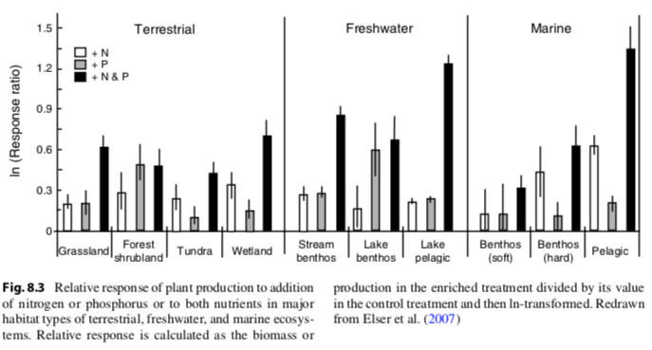
Nutrients limit productivity (primarily N and P)

Slide 5
Nutrient cycling

Slide 6
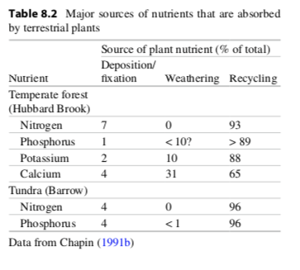
Nutrients cycle through ecosystems differently

Slide 7
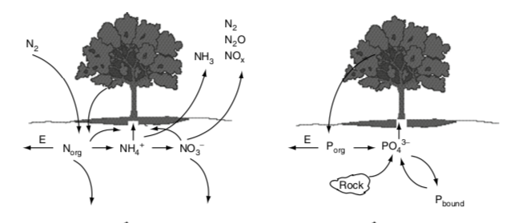

Slide 9
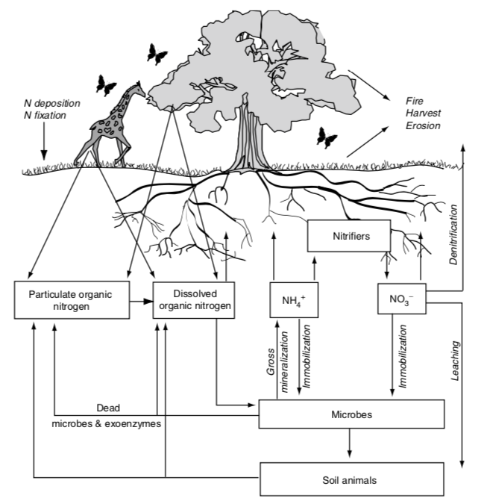
The terrestrial N cycle

Slide 10
The terrestrial N cycle
Nitrogen is constantly changing forms due to microbial activity

Slide 11
Important N forms
N₂
Nitrogen gas
Lots in the atmosphere
Cannot be taken up by plants or most microbes (just N fixers)
NO₃⁻
Nitrate
Highly mobile
Can be easily taken up by plants and most microbes
NH₄⁺
Ammonium
Mobile
Can be easily taken up by plants and most microbes
Dissolved organic N (DON)
Organic (contains C)
Produced by dead organisms
Cannot be taken up by plants
Can be broken down by microbes

Slide 14
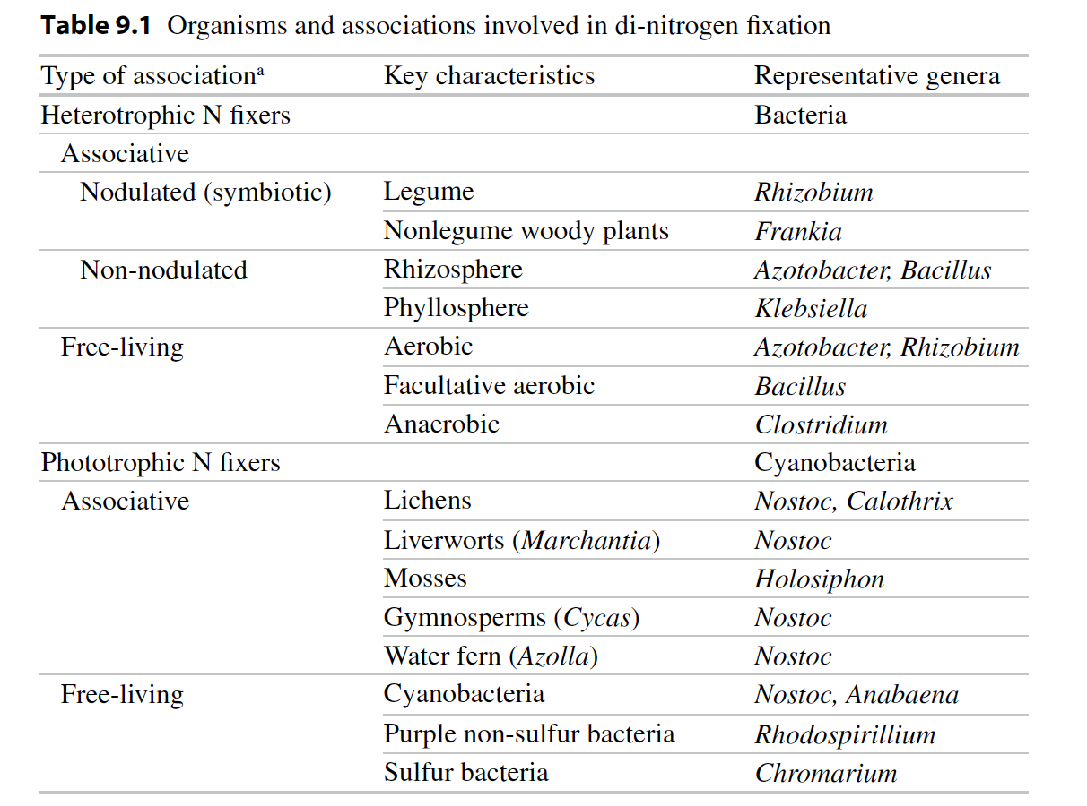
Biological N fixation: N₂ → NH₃

Slide 15
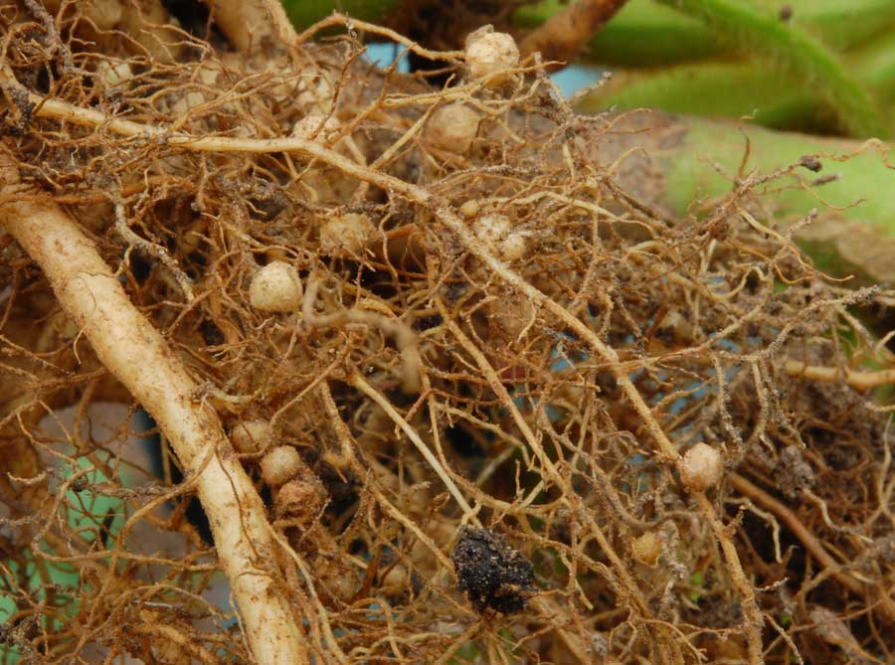
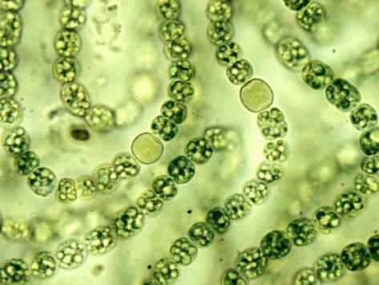
Nodules
Heterocysts
Soil Aggregates

Slide 16
Questions to ponder
Why wouldn’t all plants associate with N fixing bacteria?
Where would you expect to find plants that associate with N fixing bacteria?

Slide 17
Menge et al. (2019)

Slide 19
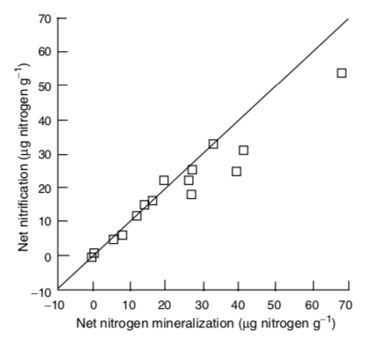
Nitrification: NH₃ → NO₂ → NO₃
Constantly happening in soil and determined by the amount of NH₃ produced by mineralization

Slide 20
Nitrification: NH₃ → NO₂ → NO₃
NH₃ amount explains spatial and temporal variability in nitrification

Slide 21
Nitrification: NH₃ → NO₂ → NO₃
Consequences
N gas production (NO, N₂O, N₂)
N more mobile

Slide 23
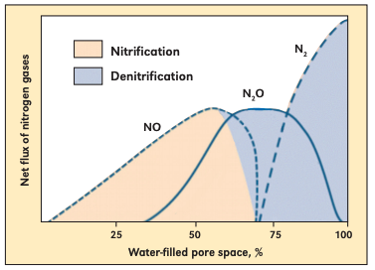
Denitrification: NO₃ → NO, N₂O → N₂
Occurs under high NO₃ and low O₂ conditions (e.g., high soil moisture)
Bouwman (1998)

Slide 25
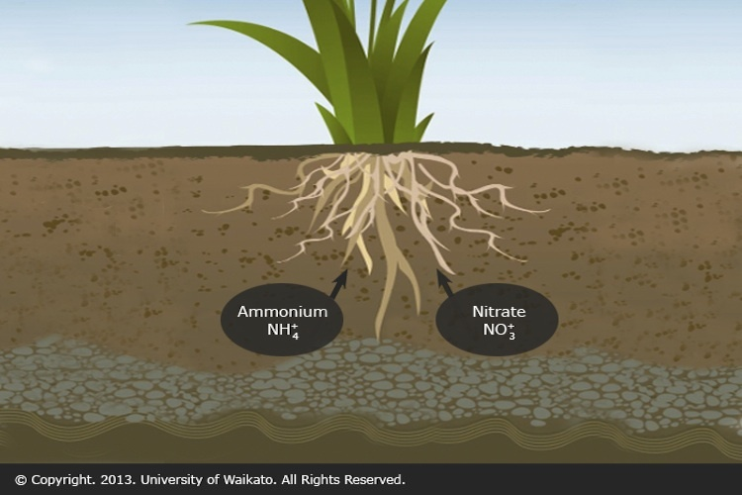
Assimilation: Inorganic N → Organic N

Slide 26
Ammonification = Mineralization

Slide 27
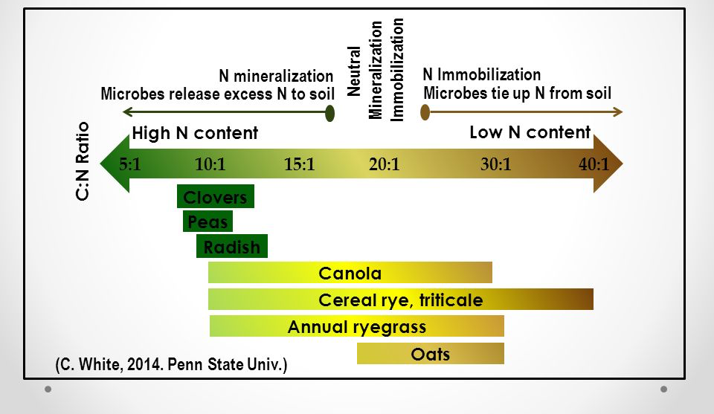
Assimilation: Inorganic N → Organic N Mineralization: Organic N → Inorganic N

Slide 28
Linkages between above- and belowground processes
Litterfall-ANPP & Litter quality
Decomposition
Microbial/decomposer activity
DON

Slide 29
Linkages between above- and belowground processes
Rate Limiting Step to N cycling ?
Depolymerization
Litterfall-ANPP & Litter quality
Decomposition
Microbial/decomposer activity
DON

Slide 30
DON
Bacteria and fungi secrete extracellular enzymes to break
complex polymers down into water soluble units that can
pass through cell membranes
Proteases Proteins Amino acids
Ribonucleases Nucleic acids Nucleotides
Chitinases Chitins
Cellulase N polymers

Slide 31
High protease activity yields more amino acids
Kielland 2006

Slide 32
Fate of DON???

Slide 33
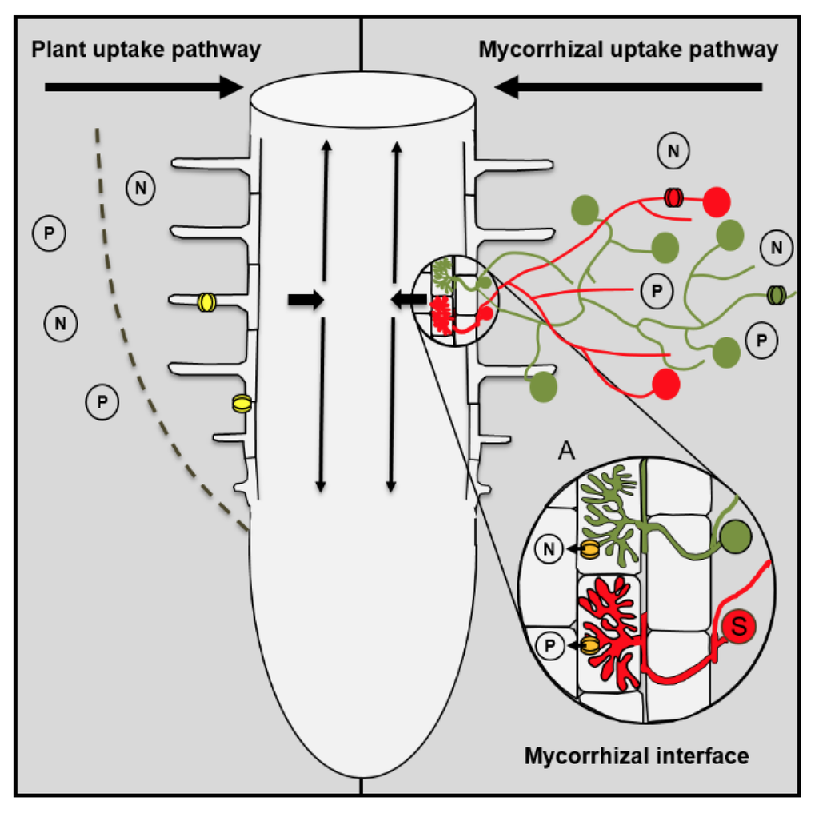
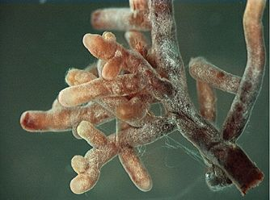
Linkages between above- and belowground processes
DON
Uptake by ECM & plants
Notes:
Taken up by plant (not too common)
Taken up by mycorrhiza
Leached to gw
Absorbed to soils
Taken up by microbes

Slide 34
Nitrogen Mineralization
•N Mineralization results from microbial break-down of DON
•Microbes release NH₄⁺ to soil solution as they use carbon
Organic-N
(R-NH₂) NH₄⁺
Mineralization
(ammonification)

Slide 35
Linkages between above- and belowground processes
CO₂
DON
NH₄⁺
Ammonification
Notes:
Taken up by plant (not too common)
Taken up by mycorrhiza
Leached to gw
Absorbed to soils
Taken up by microbes

Slide 36
Fate of NH₄⁺???
Notes:
Immobilized by another microbe
Taken up by plants
Adsorbed on soil complex (available)
Fixed on clay (unavailable)
Volatized as ammonia (NH3)
Oxidized by nitrifying microbes (nitrification)

Slide 37
Linkages between above- and belowground processes
Gross Mineralization= Total amount of N released by mineralization (NH₄⁺ and NO₃⁻)
Net mineralization= Gross – immobilization – losses (NH₄⁺ and NO₃⁻)
(available for plant uptake)
DON
NO₂⁻
NH₄⁺
NO₃⁻
Nitrification
Ammonification
Mineralization
Notes:
Taken up by plant (not too common)
Taken up by mycorrhiza
Leached to gw
Absorbed to soils
Taken up by microbes

Slide 38
Fate of NO₃⁻???
Notes:
)

Slide 39
Linkages between above- and belowground processes
Gross Mineralization= Total amount of N released by mineralization
Net mineralization= Gross – immobilization – losses (available for plant uptake)
N₂
DON
NO_{x}
N₂O
NO₂⁻
NH₄⁺
De-Nitrification
NO₃⁻
Nitrification
Ammonification
Leached to groundwater
Mineralization
Notes:
Taken up by plant
Immobilized
Leached to gw (very mobile)
Absorbed to soils
Reduced by denitrifying microbes to N2, Nox, N20

Slide 40
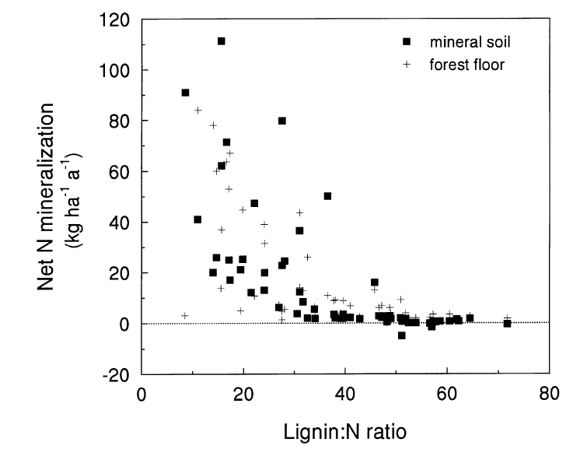
Predictable variation in litter quality impacts net N mineralization
Scott & Binkley 1997

Slide 41
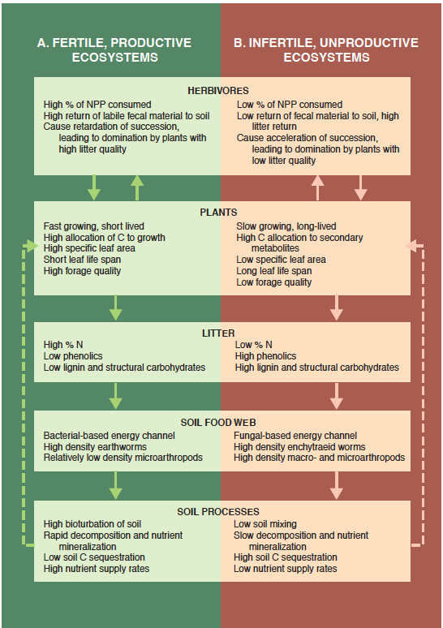
Fast Cycling Systems
Slow Cycling Systems

Slide 42
What determines whether systems are fast or slow nutrient cyclers?

Slide 43
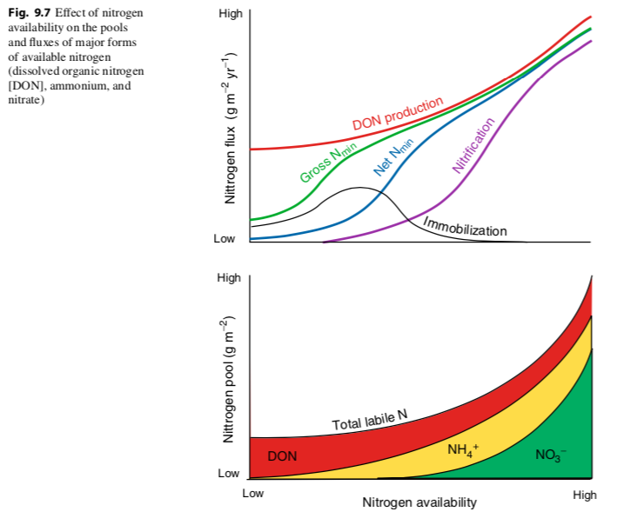

Slide 44
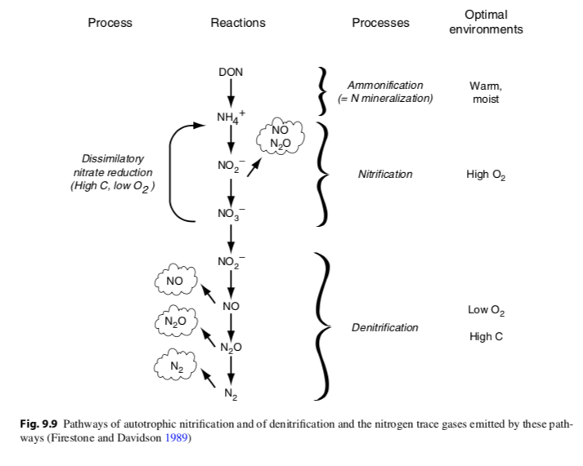

Slide 48
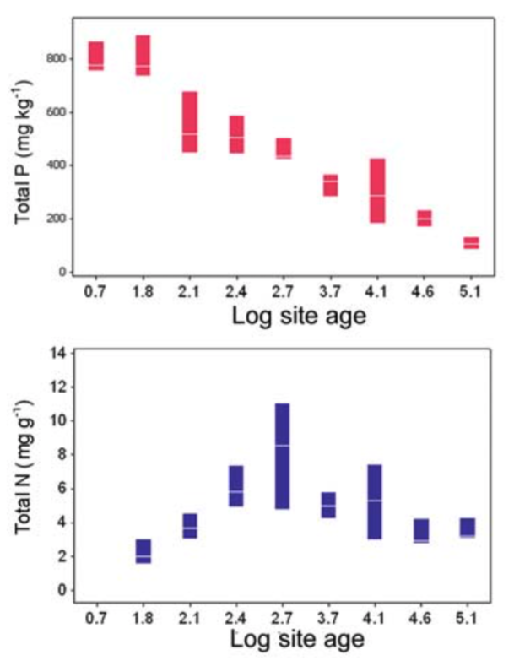
Most P enters systems through recycling

Slide 50
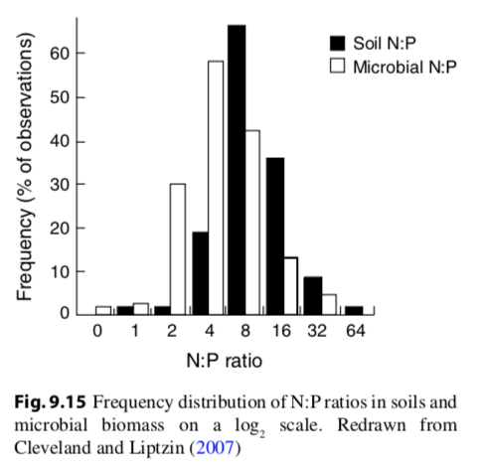
Microbes have a ton of P!
Microbial P = 20-30% total P
Microbial N = 4% total N
Microbial C = 2% total C
Microbial N:P = 7:1
Plant N:P = 28:1

Slide 51
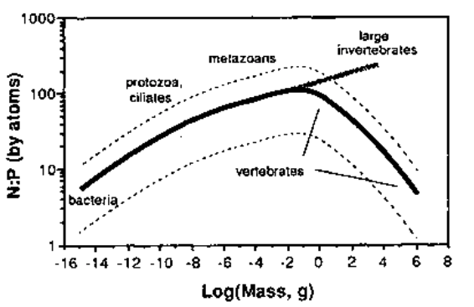
N:P tends to increase with organism size…

Slide 52
…but vertebrates are weird!

Slide 53
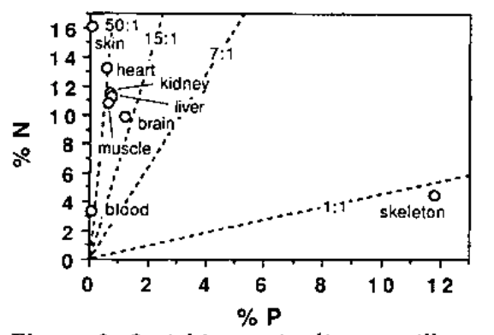

Slide 55
Mycorrhizae are very important for plant P uptake
Exchange P for C
Define the plant-soil P interface

Slide 57
Ectomycorrhizae get relatively more N than P
Arbuscular mycorrhizae get relatively more P than N

Slide 58
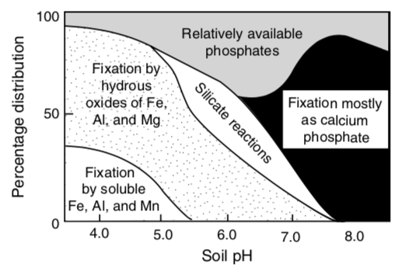
P binds to things, is more available at moderate pH

Slide 59
Agriculture

Slide 60
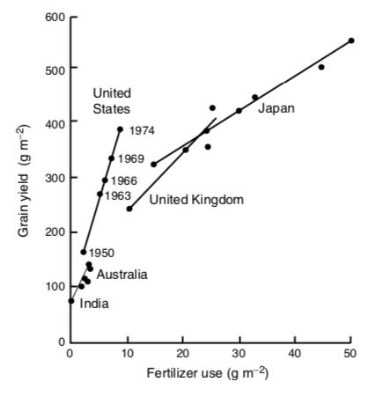

Slide 61
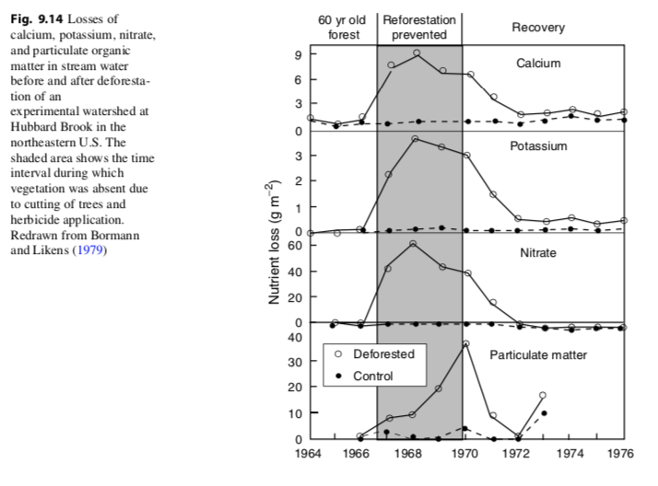

Slide 62
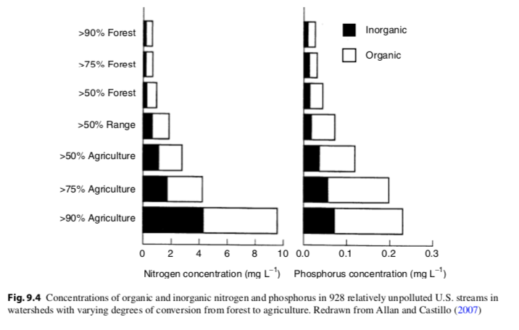

Slide 63
What might be the ecosystem impacts of fertilizer use?

Slide 64
How do we avoid these?

Slide 65
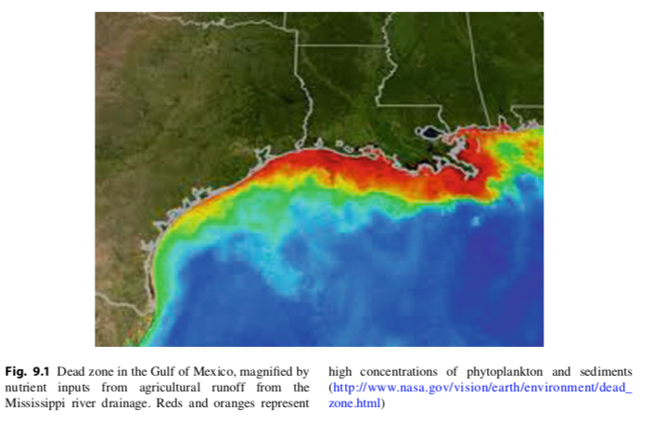

Slide 66
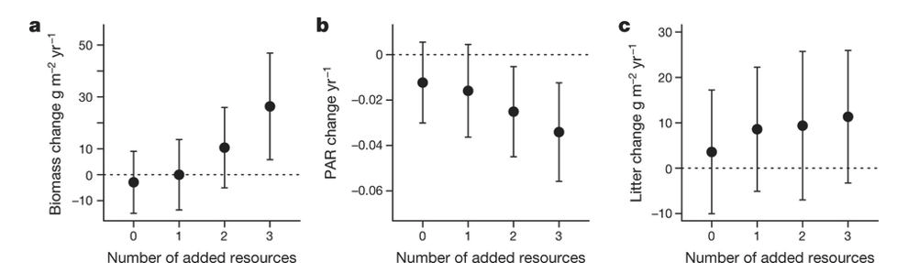
Harpole et al. (2016)

Slide 67
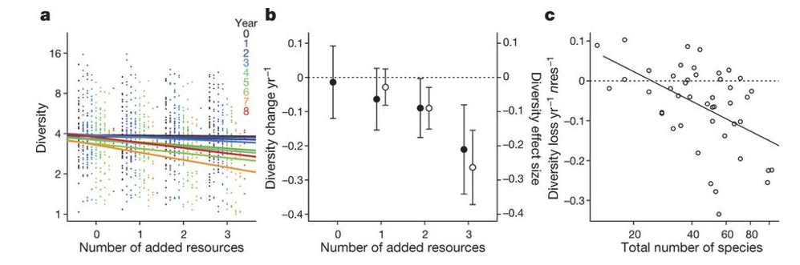
Harpole et al. (2016)

